Slide 1



Currency TRACKER
Charles Darrell Pinangat
Busisiwe Bubu Jamela
Roy Aldner Labado

Slide 2
Description
Our project is a currency (forex) tracker .
Its goal is to help you track the variations in the exchange rate of particular currencies and recieve an sms message to alert you whenever the rate rises or falls to your pre set conditions .
This allows you to send money to your desired country among other services .

Slide 3
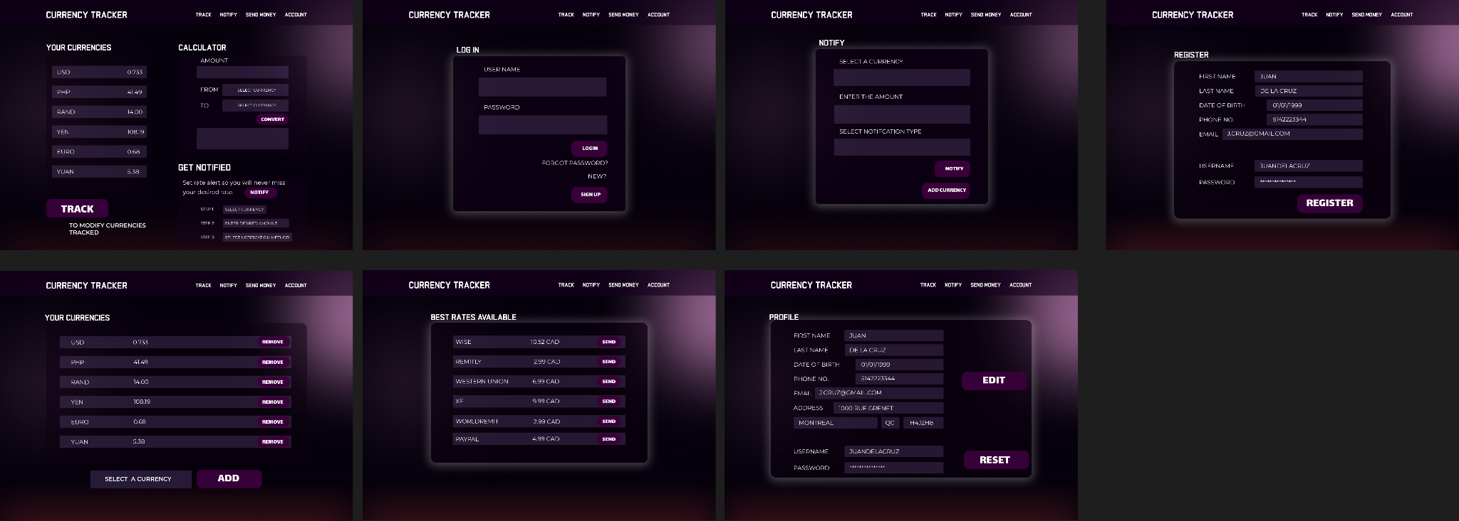
Mock-Up

Slide 4
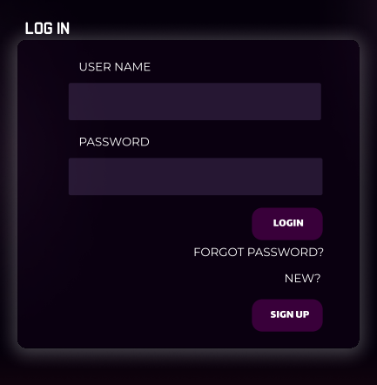
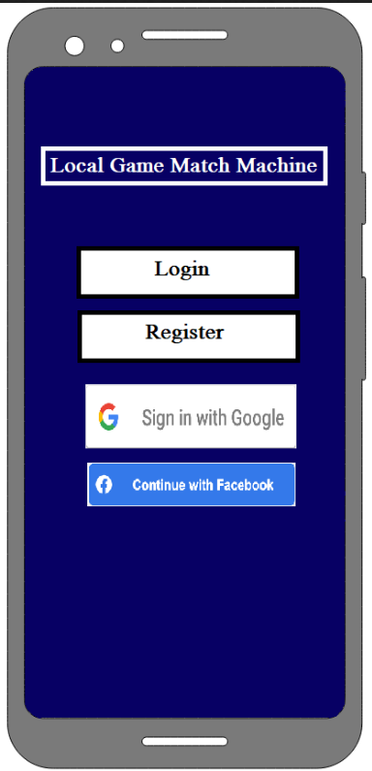
First Screen
This is the first screen of our app. It will prompt you to either login or register in order to access other functionalities.
You may sign in with Google or Facebook or with an email address.

Slide 5
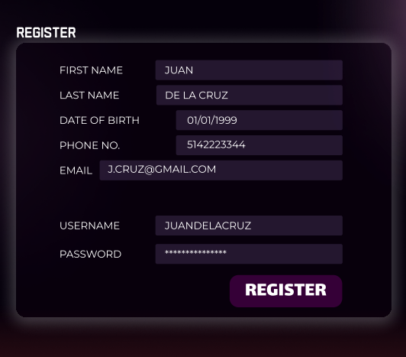
Registration -- Signup Screen
This is our registration screen. It prompts you to enter an email, an username and a password.
This information is later stored in our Firebase database.

Slide 6
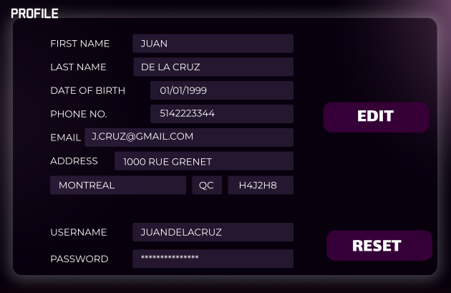
Account Profile
This page shows customer’s basic information needed for the app interaction. Privacy is always a priority. Customer may edit information as they may change and also the password when needed.

Slide 7
Login Screen
This is our login screen. It prompts you to enter your username and your password to sign in.

Slide 8
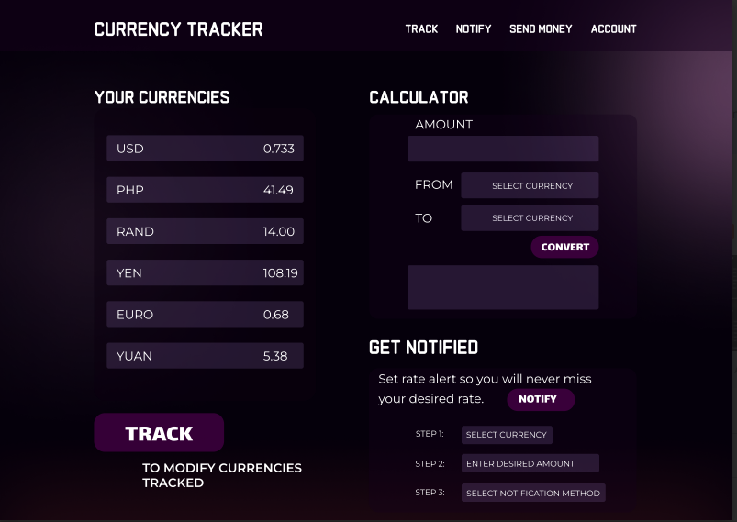
Main Screen
This is the main screen where client chooses currency and preset rates .
Keep track of currencies and method of notification .

Slide 9
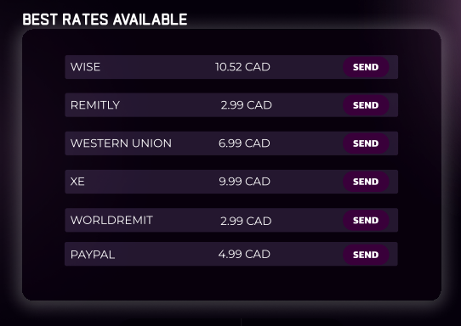
Send Money
This page shows the most affordable exchange fee rates offered by any remittance available in the country of location. Charges in these companies also varies depending on the currency.

Slide 10
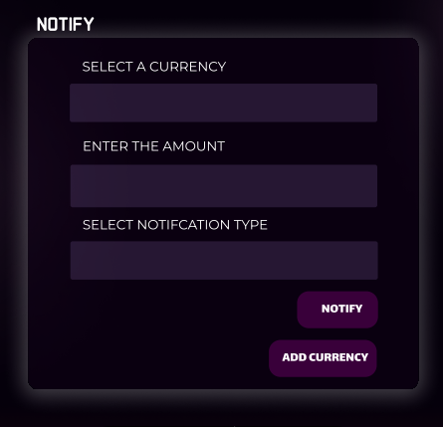
Notification
This is where you get notification when your currency reaches your level.

Slide 11
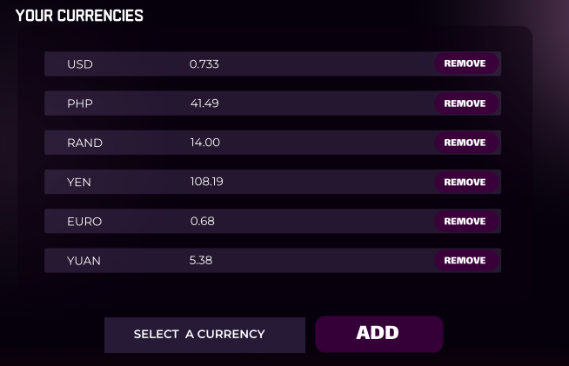
Currencies
Keep track of different currencies . Add and remove currencies of choice

